Slide 1
DA 507 modeling and optimization
Lecture 5
Integer Programming: TSP Formulation & Heuristics
Güvenç Şahin
Birol Yüceoğlu

Slide 2
Travelling Salesman Problem (TSP)
Challenge: modelling and solution
A salesman has to set out from home to visit a number of customers before finally returning home.
The problem is to find the order he should visit all customers in order to minimize total distance covered.
The distance from location i to location j is d_{ij}

Slide 3
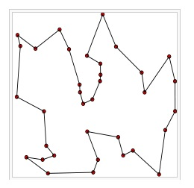
Travelling Salesman Problem (TSP)
Challenge: modelling and solution

Slide 4
The Symmetric TSP
Define the problem on a complete undirected graph G=(V, E):
  V: set of nodes/vertices
  E: set of edges/arcs/links
  (i,j) in E’(i<j) is a shortest path between i and j.
  x_{ij}= {1 if edge (i,j) belongs to the TSP tour; 0, otherwise}

Slide 5
The Symmetric TSP: Formulation
(Degree constraints)
(Connectivity constraints) -OR-
(Subcircuit elimination constraits)

Slide 6
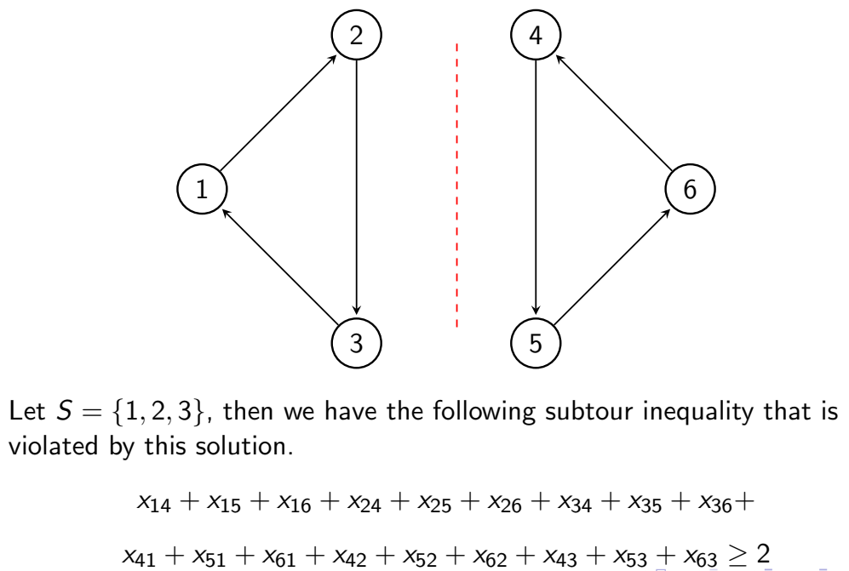
>= 2

Slide 7
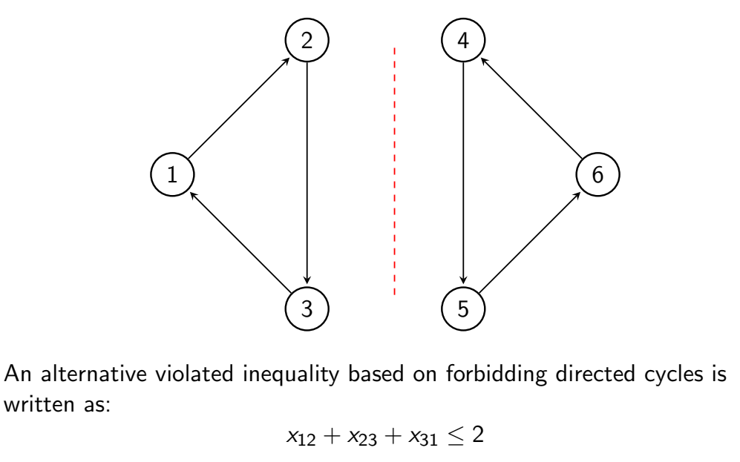

Slide 8
The Nearest Neighbor Heuristic
Constructive procedure
Adds one vertex at a time
Low quality solutions
Algorithm:
Step 0: Start at any vertex r, assign h=r
Step 1: Link vertex h to its nearest unrouted neighbor, k. Set h=k,
Step 2: If any unrouted vertices are left, go to Step 1,
otherwise link h to r, and STOP.

Slide 9
Saint Martin Example
 | 0 | 1 | 2 | 3 | 4 | 5 | 6 | 7
0 | 0 | 27.9 | 54.6 | 42.0 | 56.5 | 37.0 | 30.9 | 34.1
1 | 27.9 | 0 | 67.2 | 25.6 | 28.8 | 48.4 | 57.4 | 21.6
2 | 54.6 | 67.2 | 0 | 60.5 | 95.8 | 18.8 | 60.4 | 52.1
3 | 42.0 | 25.6 | 60.5 | 0 | 39.4 | 43.1 | 70.2 | 12.2
4 | 56.5 | 28.8 | 95.8 | 39.4 | 0 | 77.2 | 84.5 | 44.4
5 | 37.0 | 48.4 | 18.8 | 43.1 | 77.2 | 0 | 51.6 | 34.0
6 | 30.9 | 57.4 | 60.4 | 70.2 | 84.5 | 51.6 | 0 | 59.3
7 | 34.1 | 21.6 | 52.1 | 12.2 | 44.4 | 34.0 | 59.3 | 0

Slide 10
Saint Martin Example
 | 0 | 1 | 2 | 3 | 4 | 5 | 6 | 7
0 | 0 | 27.9 | 54.6 | 42.0 | 56.5 | 37.0 | 30.9 | 34.1
1 | 27.9 | 0 | 67.2 | 25.6 | 28.8 | 48.4 | 57.4 | 21.6
2 | 54.6 | 67.2 | 0 | 60.5 | 95.8 | 18.8 | 60.4 | 52.1
3 | 42.0 | 25.6 | 60.5 | 0 | 39.4 | 43.1 | 70.2 | 12.2
4 | 56.5 | 28.8 | 95.8 | 39.4 | 0 | 77.2 | 84.5 | 44.4
5 | 37.0 | 48.4 | 18.8 | 43.1 | 77.2 | 0 | 51.6 | 34.0
6 | 30.9 | 57.4 | 60.4 | 70.2 | 84.5 | 51.6 | 0 | 59.3
7 | 34.1 | 21.6 | 52.1 | 12.2 | 44.4 | 34.0 | 59.3 | 0
<0,1,7,3,4,5,2,6,0>

Slide 11
Saint Martin Example
2
3
5
7
1
4
0
6
(choose vertex 0)

Slide 12
Savings Heuristic (Clark & Wright)
Step 0: Choose an arbitrary node k (as a center node) for the tour. The starting closed walk visits each other node one by one and returns to node k after each of them.
Step 1: For all pairs of nodes i,j = 1,...,n, such that i<>k, j<>k, i<>j, calculate the savings for replacing cycles k-i-k and k-j-k by a combined cycle k-i-j-k as
s = ???
Step 2: Sort the savings in decreasing order.
Step 3: In the order of the savings, modify the current walk by replacing two edges incident to the center, i-k and k-j, by edge i-j. (The replacement is not made if i and j already belong to the same subtour.)
Repeat until a Hamiltonian cycle is formed.

Slide 13
Saint Martin Example
2
3
5
7
1
4
0
6
(choose vertex 0)

Slide 14
Saint Martin Example
d(0,5) = 37
d(0,6) = 30.9
d(5,6) = 51.6
2
3
5
Looking for
improvement
7
1
4
0
6
(choose vertex 0)
Improvement 37 + 30.9 – 51.6 = 16.3

Slide 15
Local Search Algorithms
Step 0: Start with an initial feasible solution, x⁽⁰⁾.
Set h=0.
Step 1: Enumerate feasible solutions in N(x^{(h)})
Select the best feasible solution x^{(h+1)}∈ N(x^{(h)}).
Step 2: If cost(x^{(h+1)}) < cost(x^{(h)}),
then set h=h+1 and go back to Step 1,
otherwise STOP.

Slide 16
How do you define a neighborhood?
18.8
12.2
34.0
60.4
25.6
28.8
56.5
30.9

Slide 17
k-Exchange neighborhood
18.8
12.2
34.0
60.4
25.6
28.8
56.5
30.9

Slide 18
k-Exchange neighborhood
18.8
12.2
34.0
60.4
39.4
28.8
27.9
30.9
cost reduction = ?

Slide 19
k-Exchange neighborhood
18.8
12.2
34.0
60.4
39.4
28.8
27.9
30.9
cost reduction = 39.4 + 27.9 – 25.6 – 56.5 = 14.8
z_{2-exchange}=267.2-14.8 = 252.4

